Slide 1

Clustering-Based Crime Pattern Analysis
Batch 43
221FA04108 & 221FA04135

Slide 2
Introduction to Data-Driven Crime Analysis
Crime analysis plays a vital role in ensuring public safety and effective law enforcement. With rapid urbanization, the volume of crime data has increased significantly, making traditional manual analysis methods inefficient and error-prone. These conventional approaches fail to uncover hidden spatial and temporal patterns present in large crime datasets.
To overcome these challenges, machine learning techniques, particularly clustering, are used to analyze crime data without predefined labels. Clustering helps group similar crime incidents based on location and time, enabling the identification of crime hotspots and trends. This project applies clustering-based analysis to support data-driven crime prevention and smarter urban safety planning.
Machine learning offers a transformative approach, providing intelligent and automated techniques to discover intricate patterns and anomalies within these vast crime datasets, thereby revolutionizing how we understand and combat criminal activity.

Slide 3
Addressing the Limitations of Traditional Crime Analysis
Manual Analysis: Time-Consuming & Error-Prone
Failure to Identify Complex Patterns
Need for Automated, Data-Driven Solutions
Existing systems struggle to detect sophisticated spatial, temporal, and behavioral crime patterns that are not immediately obvious. This limits proactive intervention and strategic planning.
There is an urgent demand for an automated, intelligent system capable of efficiently processing large datasets to detect crime hotspots, predict trends, and inform effective law enforcement strategies.
Traditional methods of crime analysis are inherently slow, resource-intensive, and susceptible to human biases and inaccuracies. This often leads to delayed responses and missed opportunities in crime prevention.

Slide 4
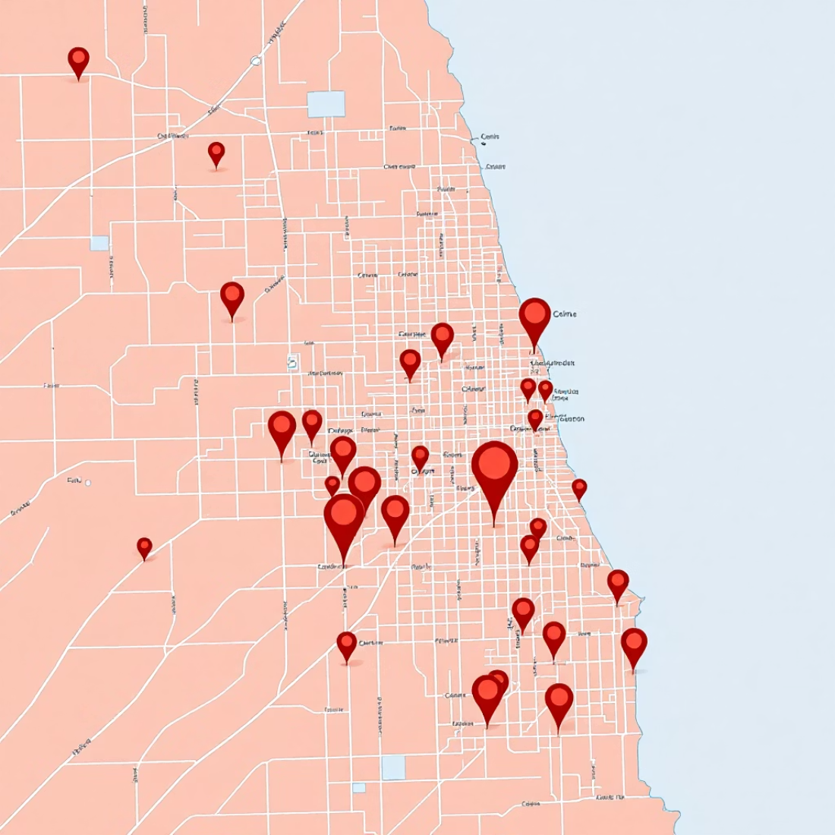
The Chicago Crime Dataset: A Foundation for Analysis
For this project, we utilize the comprehensive Chicago Crime Dataset, a robust public resource available through Kaggle and the official Chicago Data Portal. This dataset provides a rich source of information for granular analysis, encompassing a wide range of criminal incidents over several years.
Key Attributes for Deep Insight:
Crime Type: Categorization of offenses (e.g., robbery, assault, theft).
Date and Time of Occurrence: Precise timestamps enabling temporal pattern analysis.
Latitude and Longitude: Geographic coordinates for precise spatial mapping and hotspot identification.
Location Description: Contextual details about the crime scene (e.g., street, residence, business).
The richness of this dataset is crucial for effective spatial and temporal crime analysis, allowing us to build a highly accurate
and insightful model.

Slide 5
Key Objectives: Driving Actionable Insights
Identify High-Crime Areas
Utilize advanced clustering algorithms to pinpoint geographically concentrated zones with elevated criminal activity.
2. Analyze Spatial & Temporal Patterns
Uncover how and when crimes occur across different locations, revealing critical recurring trends and anomalies.
3. Visualize Crime Hotspots
Develop intuitive and interactive maps that visually represent crime concentrations and their evolution over time.
4. Assist Law Enforcement
Provide data-driven recommendations and tools that aid police agencies in resource allocation and strategic decision-making.

Slide 6
Robust System Architecture for Crime Analytics
01
02
03
1. Crime Data Collection
2. Data Preprocessing & Cleaning
3. Feature Extraction & Selection
Gathering raw crime incident data from official sources, ensuring comprehensive coverage and initial data integrity.
Transforming raw data into a usable format, addressing missing values, inconsistencies, and errors to enhance data quality.
Identifying and engineering relevant features (e.g., location, time) that significantly influence crime patterns for model input.
04
05
4. Clustering Algorithm Application
5. Visualization & Analysis
Applying chosen machine learning algorithms to group similar crime incidents and identify distinct patterns and hotspots.
Presenting the results through interactive maps and graphs, enabling clear interpretation and actionable insights.
This modular architecture is designed for optimal scalability, maintainability, and clarity, ensuring each stage contributes effectively to the overall analytical pipeline.

Slide 7
Proposed Methodology: A Step-by-Step Approach
Step 1: Data Preprocessing
Crucial initial phase involving handling missing values, standardizing formats, and normalizing data to ensure consistency and model readiness.
Step 2: Feature Selection
Carefully selecting the most impactful features, such as precise location coordinates (latitude, longitude) and temporal attributes (date, time of day), to optimize clustering performance.
Step 3: Clustering Application
Implementing robust clustering algorithms like K-Means and potentially DBSCAN to segment crime incidents into meaningful, distinct groups based on their intrinsic similarities.
Step 4: Visualization
Step 5: Analysis & Interpretation
Creating compelling visual representations, including dynamic hotspot maps and insightful trend graphs, to make complex data understandable and interpretable.
Thoroughly examining the clustering results, identifying underlying patterns, and translating them into actionable intelligence for law enforcement agencies.

Slide 8
Clustering Algorithms: Unlocking Crime Patterns
K-Means Clustering
DBSCAN (Density-Based Spatial Clustering of Applications with Noise)
K-Means is a centroid-based clustering algorithm that partitions 'n' observations into 'k' clusters. Each observation belongs to the cluster with the nearest mean, serving as a prototype of the cluster. It's highly effective for:
DBSCAN is a powerful density-based clustering algorithm that groups together points that are closely packed together, marking as outliers points that lie alone in low-density regions. Its key advantages include:
Hotspot Detection: Efficiently identifying regions with high crime density by grouping spatially proximate incidents.
Irregular Shaped Clusters: Capable of discovering clusters of arbitrary shape, unlike K-Means.
Scalability: Performing well on large datasets due to its computational efficiency.
Noise Identification: Automatically distinguishing noise points from core clusters, which is crucial for real-world crime data that often contains anomalies.
Ease of Implementation: Relatively simple to understand and deploy.
No Predefined 'K': Does not require the number of clusters to be specified beforehand.
The strategic application of these algorithms allows us to robustly identify crime concentrations and understand their underlying structures.

Slide 9




Tools and Technologies Utilized
Programming Language: Python
Chosen for its versatility, extensive library ecosystem, and strong community support in data science and machine learning.
Libraries: Pandas, NumPy, Scikit-learn
Foundation for data manipulation (Pandas), numerical operations (NumPy), and machine learning algorithms (Scikit-learn).
Visualization: Matplotlib, Seaborn, Folium
Powerful tools for static and interactive data visualization, including statistical plots and geographical maps.
IDE: Jupyter Notebook / VS Code
Integrated Development Environments providing interactive computing for exploratory data analysis and code development.

Slide 10
Project Outcomes: Empowering Law Enforcement
Precise Crime-Prone Zone Identification
Clear delineation of areas with historically high criminal activity, enabling targeted resource allocation and enhanced patrols.
Intuitive Visual Crime Hotspot Maps
Interactive and easy-to-understand maps that illustrate crime concentrations, patterns, and their evolution over time.
Improved Understanding of Crime Distribution
Deeper insights into the spatial and temporal dynamics of crime, leading to more informed strategic planning.
Enhanced Support for Preventive Strategies
Providing law enforcement agencies with data-driven intelligence to develop proactive crime prevention measures and community initiatives.

